Slide 1
Week 8: Spark Streaming in Databricks
Auto Loader & Ingestion Patterns (Azure Databricks) – v2

Slide 2
Learning Objectives
Use Auto Loader for file-based incremental ingestion.
Compare listing vs notifications modes.
Configure checkpoints & schema evolution.
Build Bronze → Silver with Delta.

Slide 3
Agenda
Why Streaming on the lakehouse
Structured streaming mental model
Triggers, watermarks, and stateful ops
Streaming joins: stream–static & stream–stream
Auto Loader overview
Discovery modes
Core options: schemaLocation, checkpoints, evolution
Hands-on demo plan
Performance & pitfalls
Wrap-up

Slide 4
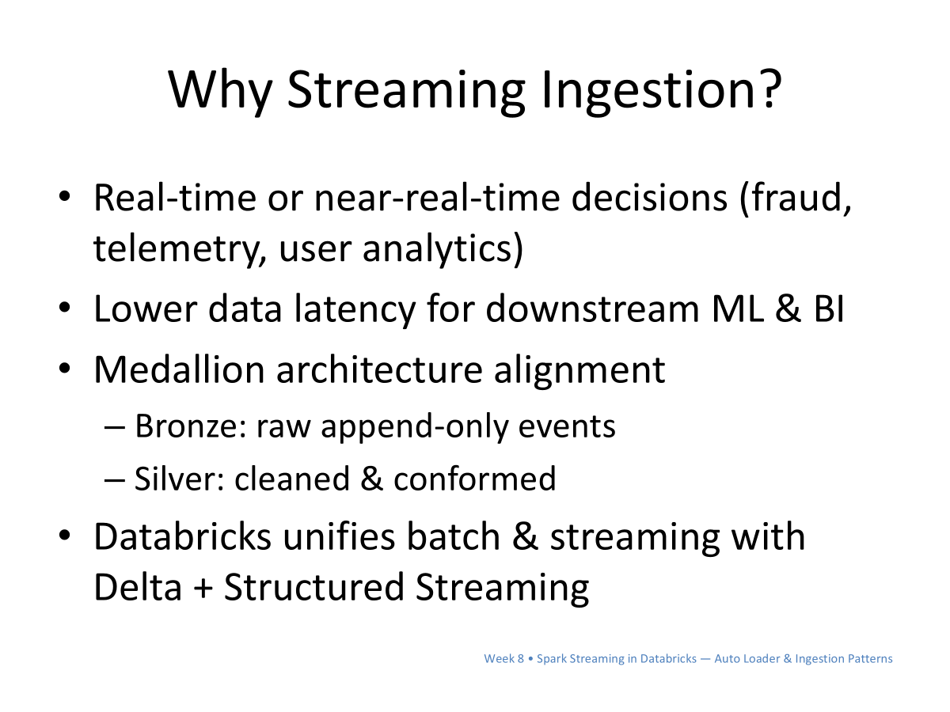

Slide 5
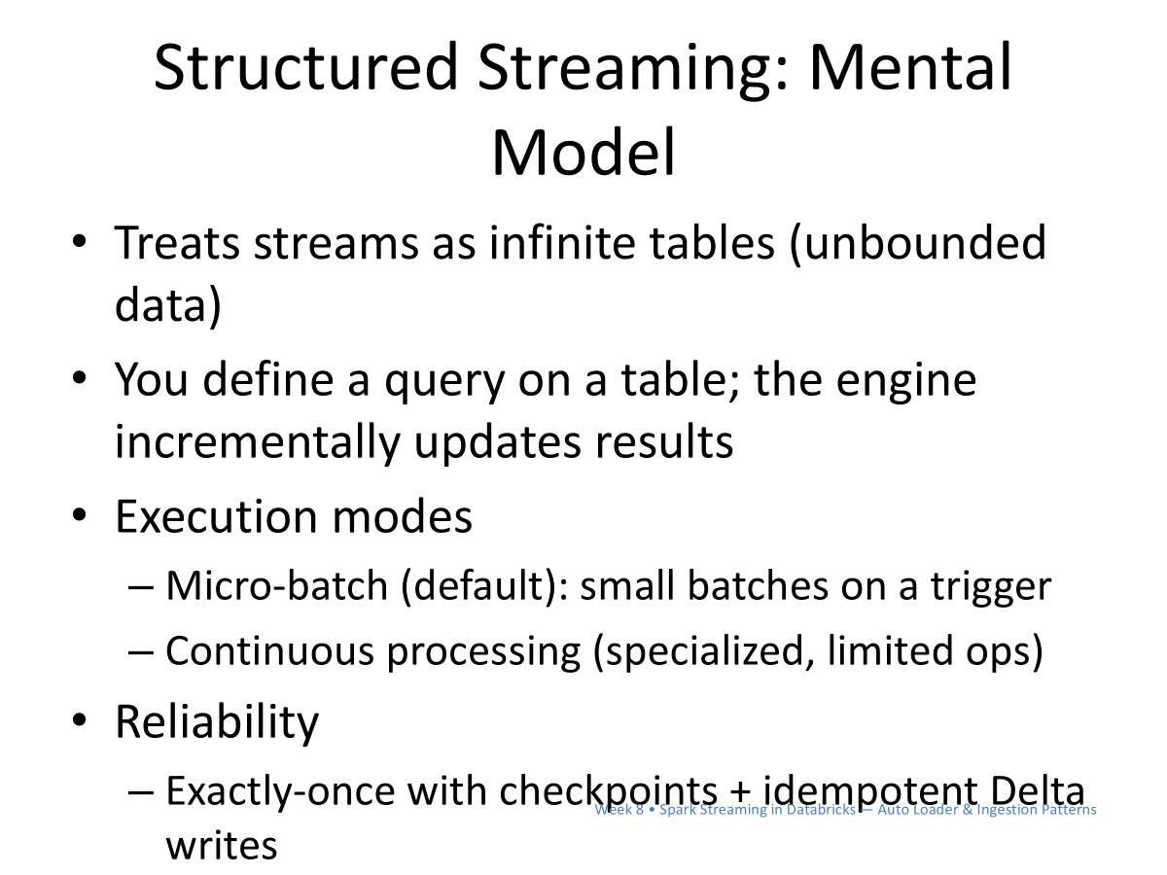

Slide 6
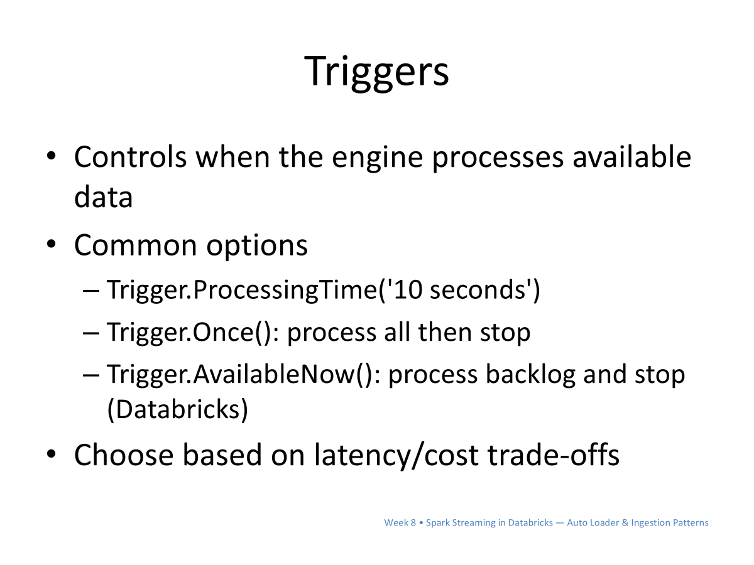

Slide 7
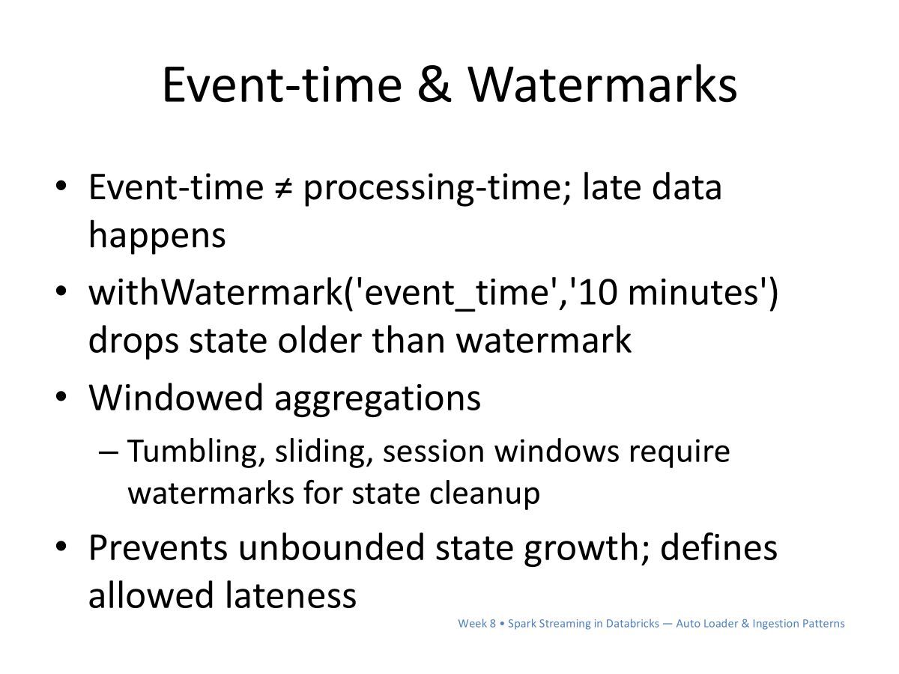

Slide 8
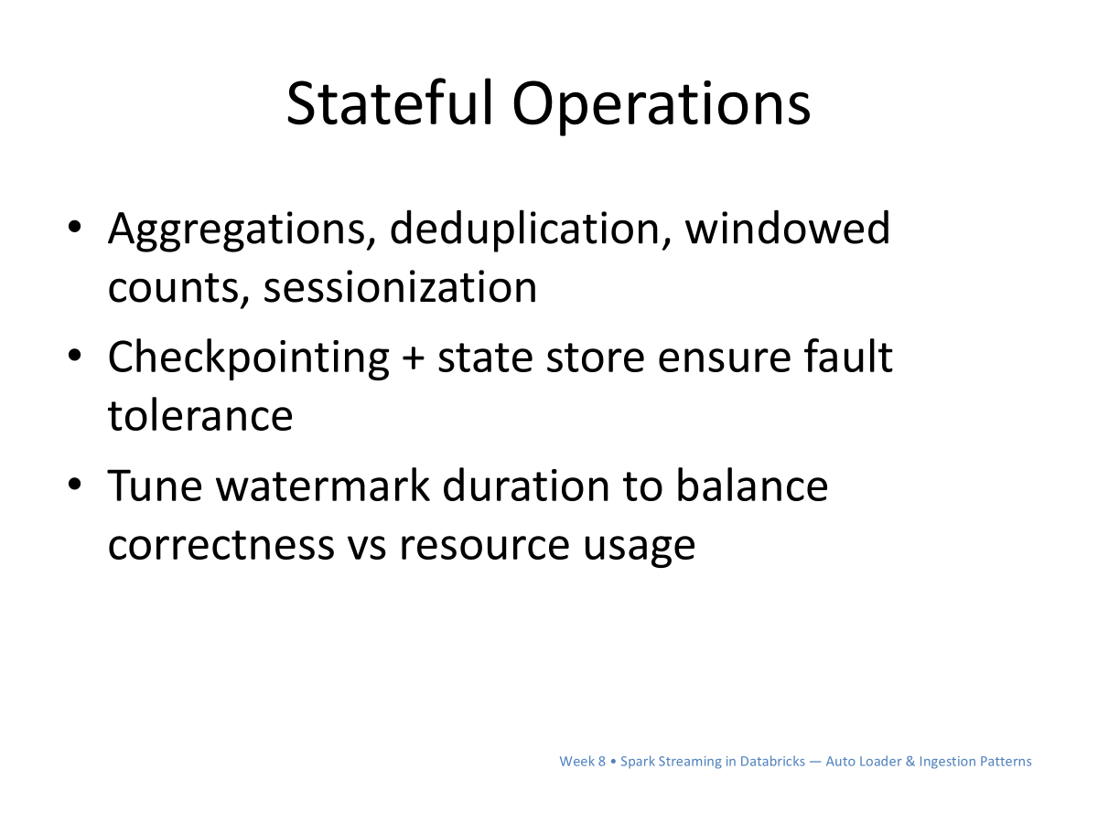

Slide 9
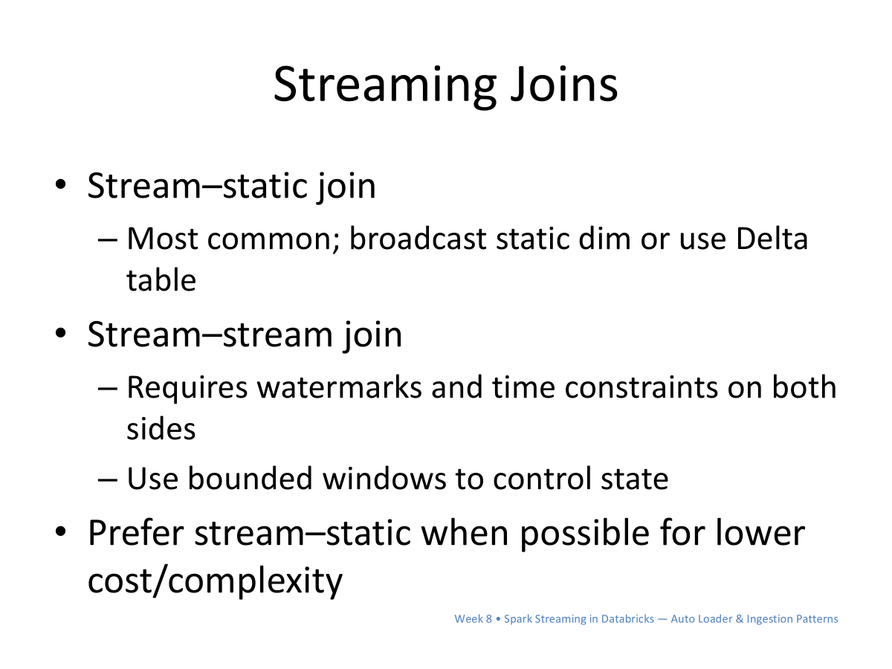

Slide 10
BASICS
Why it matters

Slide 11
What is Auto Loader?
Structured Streaming source for new files.
Exactly-once with checkpoints.
Schema tracked via schemaLocation.
Auto Loader incrementally and efficiently processes new data files as they arrive in cloud storage without any additional setup

Slide 12
Benefits of Auto loader over Structured streaming
Scalability: Auto Loader can discover billions of files efficiently. Backfills can be performed asynchronously to avoid wasting any compute resources.
Performance: The cost of discovering files with Auto Loader scales with the number of files that are being ingested instead of the number of directories that the files may land in. See Auto Loader streams with directory listing mode.
Schema inference and evolution support: Auto Loader can detect schema drifts, notify you when schema changes happen, and rescue data that would have been otherwise ignored or lost. See How does Auto Loader schema inference work?.
Cost: Auto Loader uses native cloud APIs to get lists of files that exist in storage. In addition, Auto Loader's file notification mode can help reduce your cloud costs further by avoiding directory listing altogether. Auto Loader can automatically set up file notification services on storage to make file discovery much cheaper.

Slide 13
Incremental Flow
Watch prefix → readStream('cloudFiles') → Delta Bronze.
Downstream to Silver/Gold (stream/batch).
Backfill with trigger(availableNow=True).

Slide 14
MODES
Directory listing vs notifications

Slide 15
Directory Listing
No infra; polls storage
Simple; good for small/medium volumes
More list ops at scale

Slide 16
File Notifications
Event-driven (Event Grid + Queue)
Lower latency/cost at scale
Needs cloud setup; ABFSS paths
cloudFiles.useNotifications = true

Slide 17
Auto Loader in the Medallion Architecture (Concept Diagram)
ADLS Gen2
(container/prefix)
Auto Loader
(cloudFiles)
Delta Bronze
(checkpoint + schemaLocation)
Delta Silver/Gold
(MERGE/Aggregations)

Slide 18
CORE OPTIONS
Reliability & evolution

Slide 19
Key Options
cloudFiles.format = 'json'|'csv'|'parquet'|...
cloudFiles.schemaLocation = '<path>'
cloudFiles.inferColumnTypes = 'true'
cloudFiles.schemaEvolutionMode = 'addNewColumns'
checkpointLocation = '<path>'
cloudFiles.useNotifications = 'true'

Slide 20
Pitfalls
Missing schemaLocation
Reusing checkpoints across queries
Aggressive cleanup removing logs
No handling for malformed records

Slide 21
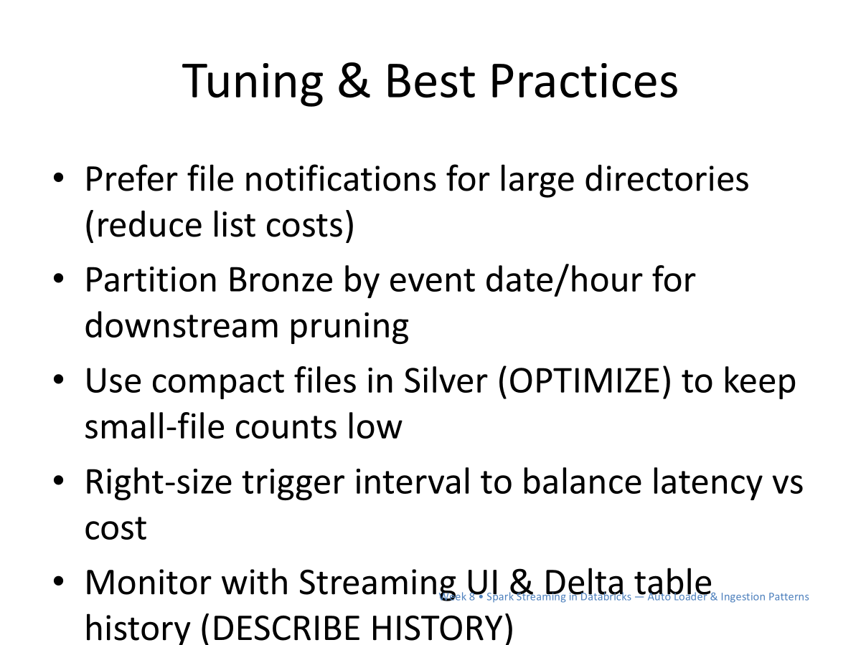

Slide 22
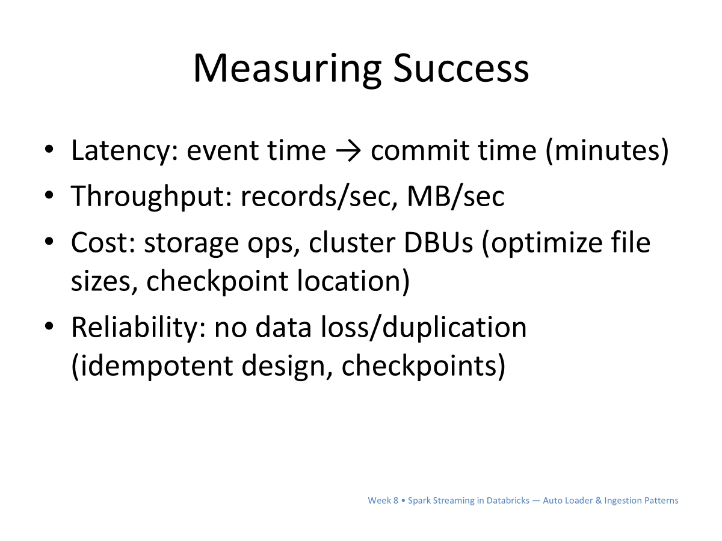

Slide 23
Wrap-Up & Next
Auto Loader simplifies incremental ingestion
Next: stream-stream joins & watermarks

